Slide 1
Cleaning, Organizing, & Executing Raw Data
By Alexander Melchor

Slide 2
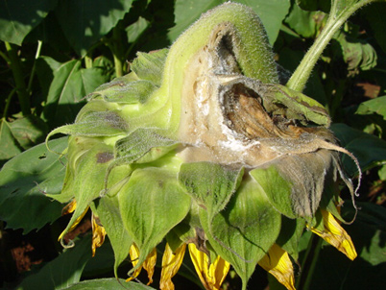
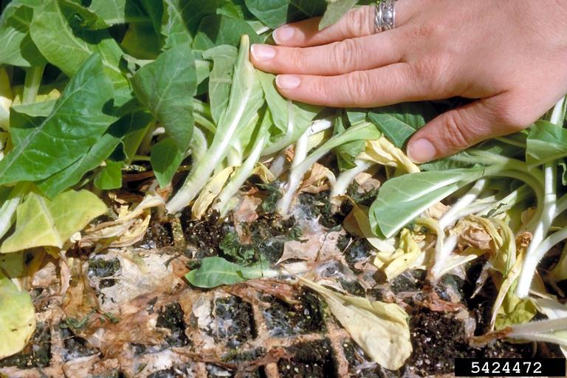
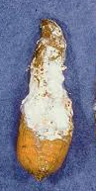
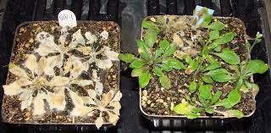
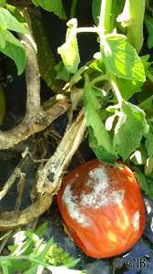
Research Background
Sclerotinia sclerotiorum is a necrotrophic fungus that kills plant host cells
There is no full resistance against S. sclerotiorum in more than 600 plant species
Plants engage in “chemical warfare” with pathogens by producing metabolites with antimicrobial properties
Model plant Arabidopsis
thaliana
Sunflower
Tobacco
Carrot
Tomato
Notes:
In a 2012 article by Peltier et al. In 2009, there was an estimated 560-million-dollar loss revenue in soybeans only.

Slide 3
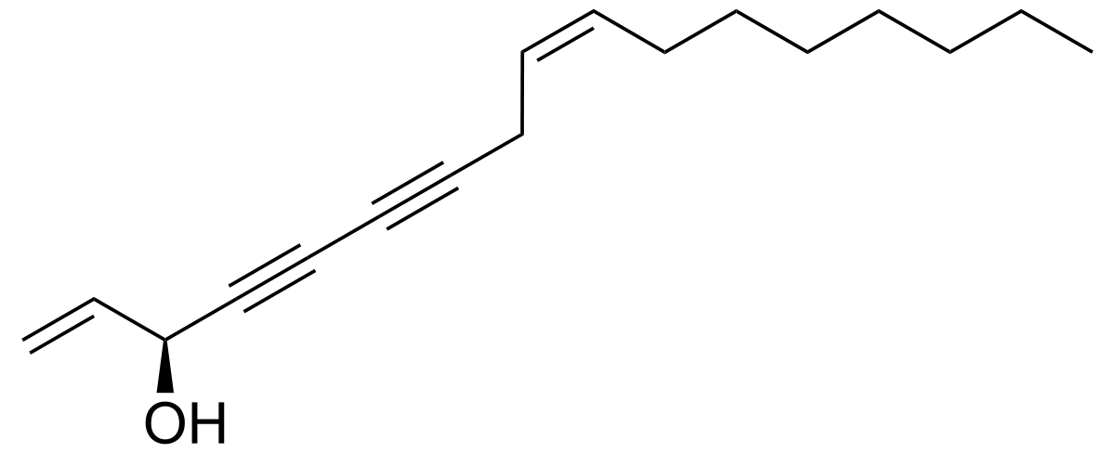
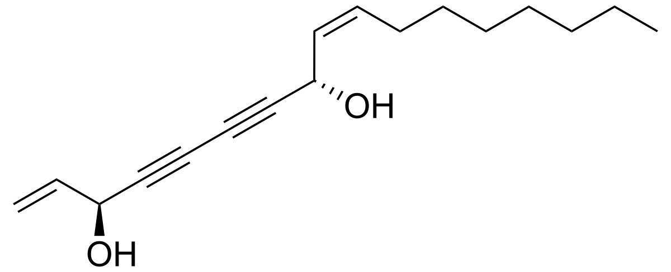
Research Background
Carrots (Daucus carota) produce antimicrobial falcarins
Falcarinol and falcarindiol
Most common falcarins found in carrot skin
Jasmonic acid
Signaling molecule
Prepares plants to defend themselves against pathogens
Falcarinol
Falcarindiol
Jasmonic Acid
Notes:
What are phytohormones? They are signaling molecules that are important for plant defense against pathogens
Such as Jasmonic acid, absicisic acid, salicylic acid, and ethylene
Their concontrations are increased when plants are being attack by necrotrophic pathogen
Our lab works on S. sclerotiorum, it’s a necrotrophic pathogen
Its’ a fungus, that kills the plant so that they can get their nutrients from the dead host
Causes major loss in agriculture
Carrots first
If I eat the plant – you can die because it’s poisonous
Put picture of Jasmonic acid as well

Slide 4
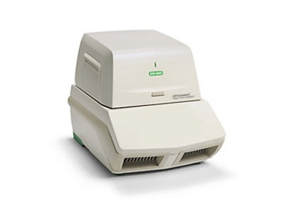

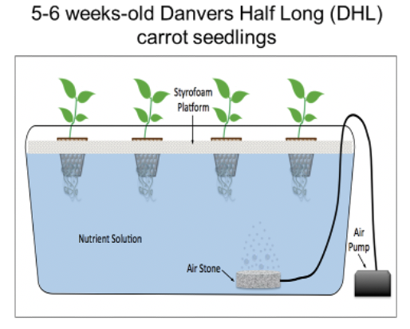

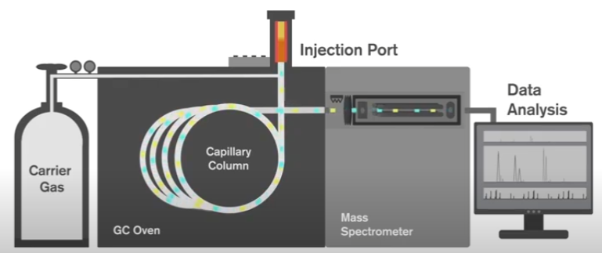

Methods
RT-qPCR
Mock
Gas Chromatography-Flame Ionization Detector (FID)
Jasmonic acid
Notes:
Mention the time point and concentration of MeJA here

Slide 5
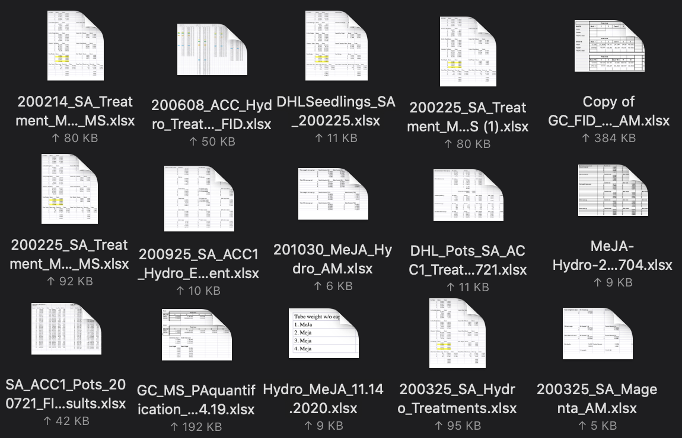
Entropy
Folders were a mess with excessive excel sheets
Hard to figure out which excel sheets were for which project
Notes:
It was mainly hard to see which samples were for which because:
We constantly used the same phytohormones
There were 2-3 students working on the same project together
This caused errors on dates – some students put the date of when plant was treated, others put the date when they ran the samples on the GC-FID, lastly, people put the date of when it was analyzed!
People continued to mess with the raw data for the calculations of each sample when not suppose too
Entropy: disorder – where entropy is favored

Slide 6
Goal
Clean raw data from gas chromatography-flame ionization detector (GC-FID)
Execution of clean raw data to give statistical analysis
Organize all the excel sheet or csv files from each experiment and combine into one folder.
Notes:
So, since I am graduating – my professor told me that I need to show her all the excel sheets, samples, and treatments that were done
I had to do it because I was the lead on the projects
This is where I saw that I was in big trouble!

Slide 7
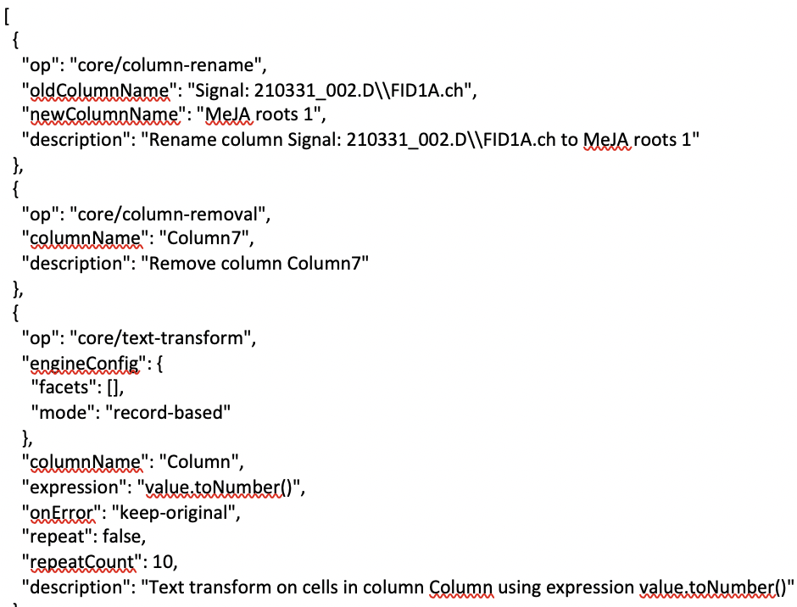
Cleaning Raw Data for the Python Script
OpenRefine to clean data
Necessary for specific things needed to analyze and not confuse any other number
Converted to csv

Slide 8
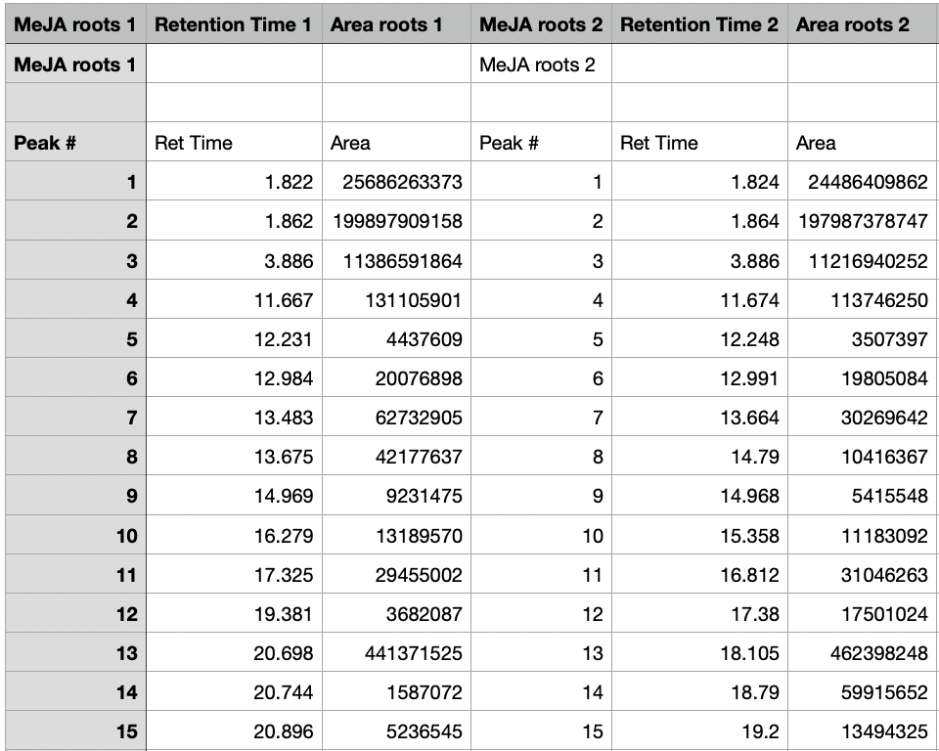
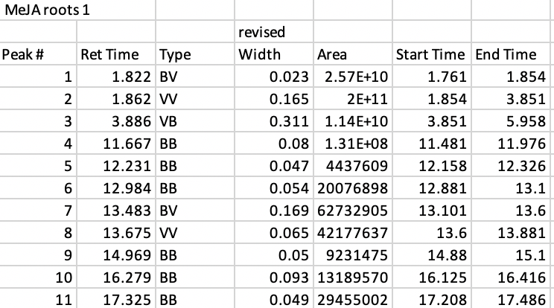
Clean vs Raw

Slide 9
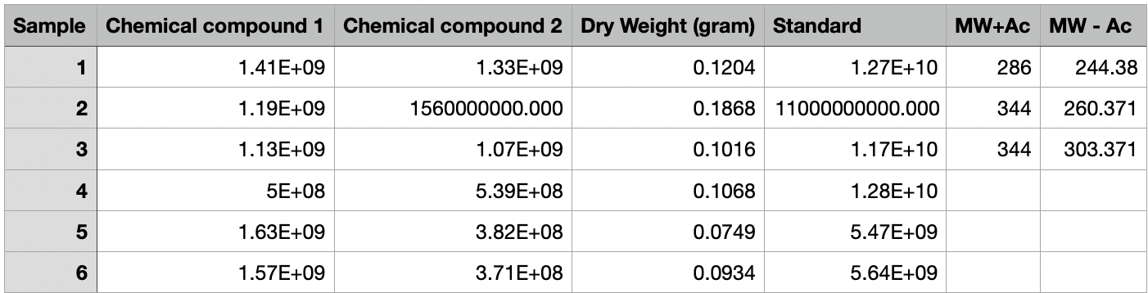
Final Product

Slide 10
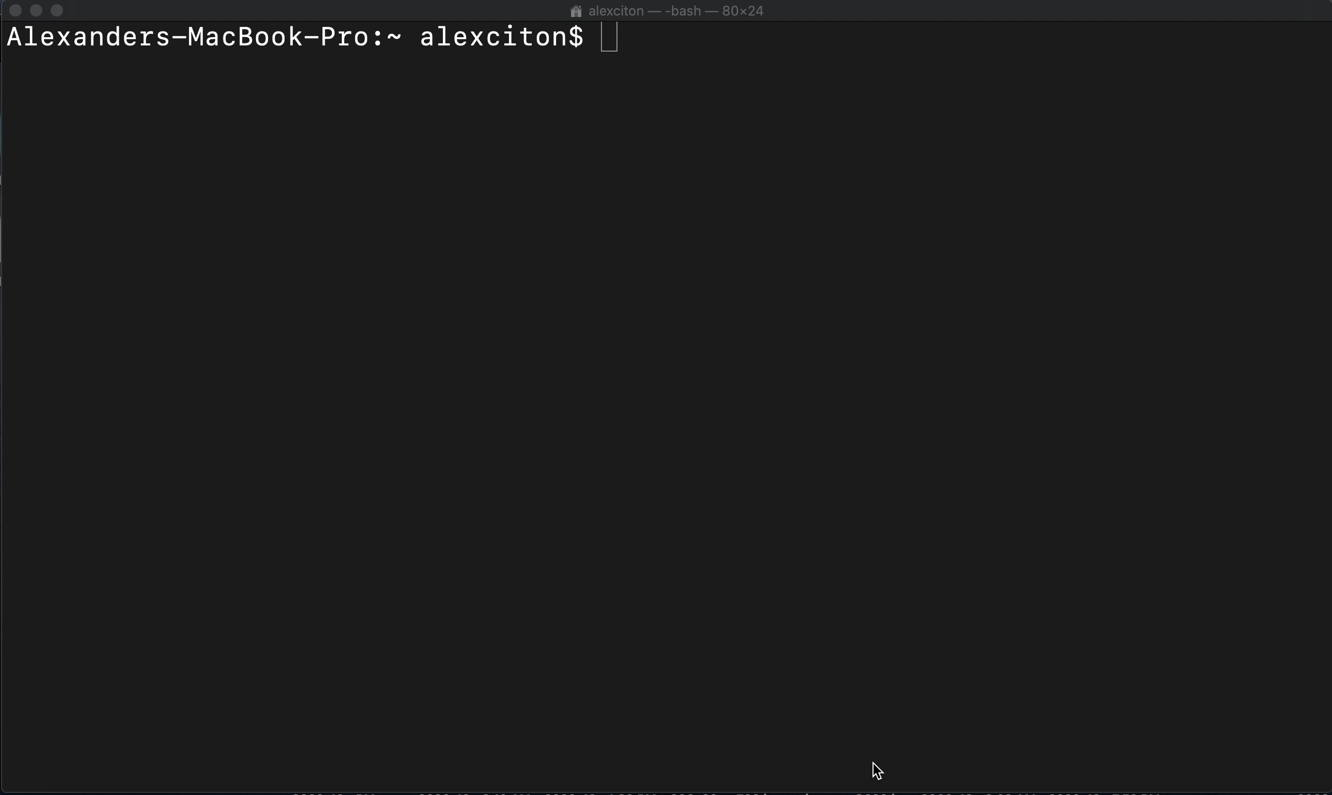
Results
Executing Python Script for Data for Analysis

Slide 11
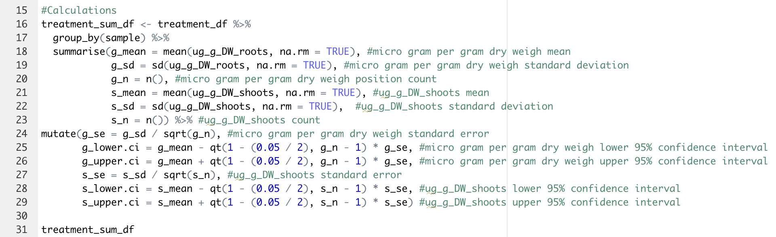
R-Script (thank you Trevor and Josh!)

Slide 12
Data

Slide 13
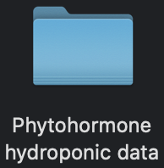
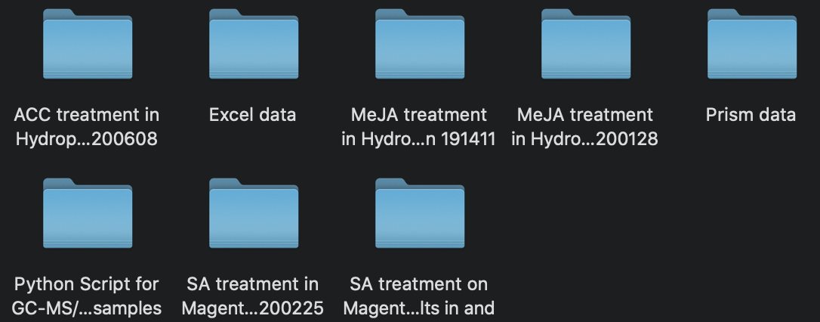
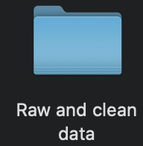
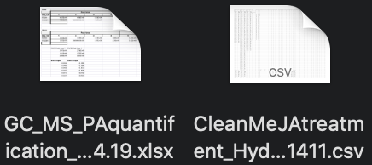
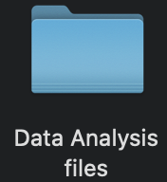
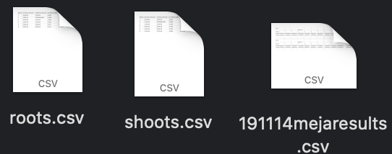

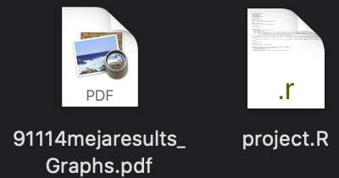
Organization of Data per Experiment

Slide 14
Conclusion
Able to clean GC-FID raw data by OpenRefined
Execute the analysis of GC-FID data via python script
Graph my data utilizing R/ggplot
Organizing all data within its own folder.

Slide 15
Thank you

